Slide 1

EEG data analysis and visualization
Prepared by
Suyog chavan (71)
Ritesh shende (72)
Rushikesh shinde (73)
Sanket pophale (75)
Under the guidance of
Prof. h. ohal

Slide 2
contents
introduction to EEG
Motivation
Introduction to Project
Problem Definition
Proposed Methodology
Project Architecture
Literature Survey
Resources Required
References

Slide 3
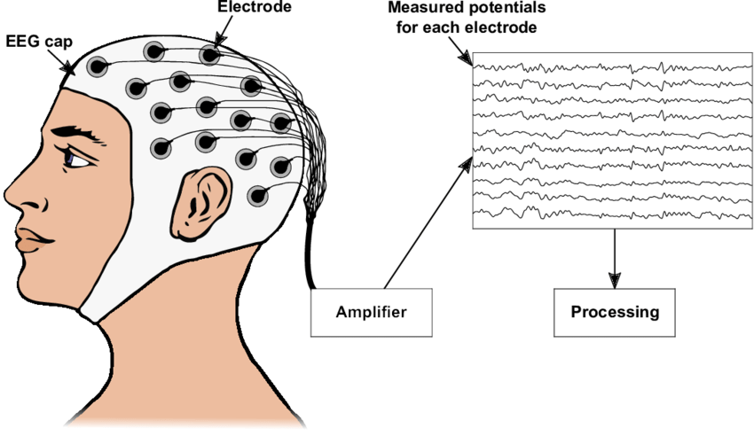
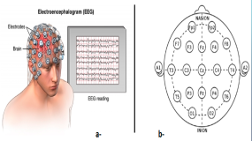
Introduction to eeg
Electroencephalography (EEG) measure the weak electromagnetic signals generated by neuronal activity in the brain.

Slide 4


Slide 5
motivation
An electroencephalogram, or EEG, is used to monitor the electrical activity in the brain through electrodes placed on the scalp
EEG useful in diagnosing brain disorders.
Manual scanning and interpretation of EEGs is time-consuming since these recordings may last hours or days. It is also an expensive process as it requires highly trained experts.

Slide 6

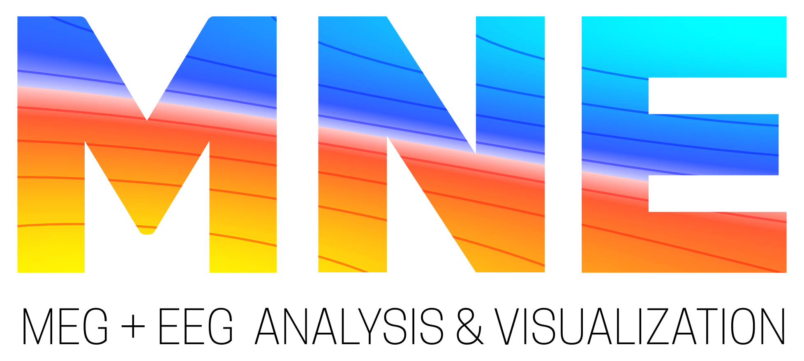


Introduction to project
The main aim of this project is to making an EEG data easier to understand and analyze by using some enhanced and advanced 3D graph and diagram plotting technics available in python.
MNE-Python
For Scientific computation (NumPy, SciPy)
For Visualization (Matplotib, Mayavi)

Slide 7
Problem Definition
Develop a project that will help one to analyze an EEG signal data. Develop a program or a way to visualize all this huge data in advanced and enhanced user-friendly view so, people can visualize EEG data in 3D. EEG analysis is widely used in brain-disease diagnosis and assessment. This project shall be helpful for that field also. Analyzing EEG data and represent it in such way that user can interact with it and can see it however they want to see.

Slide 8
Proposed methodology
The targets of EEG analysis are to help researchers gain a better understanding of the brain; assist physicians in diagnosis and treatment choices; and to boost brain-computer interface technology.
Non-invasive electroencephalogram (EEG)-based brain-computer interfaces can be characterized by the technique used to measure brain activity and by the way that different brain signals are translated into commands that control an effector (e.g., controlling a computer cursor for word processing and accessing the internet).

Slide 9
project architecture
Raw EEG database
Importing data into Python
Data Pre-Processing
Plot 2D graph
Plot 3D graph
Visualization

Slide 10
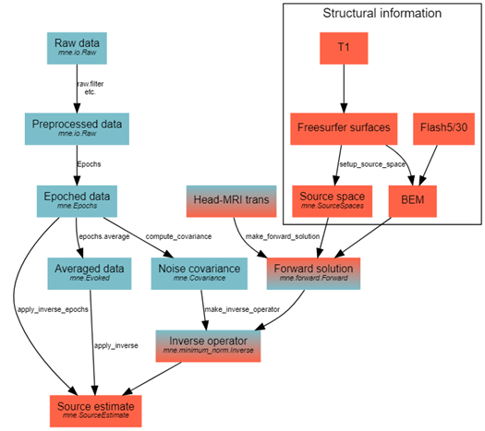
MNE EEG workflow diagram

Slide 11
Literature review
IEEE Xplore, 24 June 2010 ➔ Using Python for Signal Processing and Visualization
IEEE Xplore, 28 January 2016 ➔ Enhanced three-dimensional visualization of EEG signals
IEEE Xplore, 04 November 2013 ➔ Classification and visualization for EEG data
IEEE Xplore, 09 February 2017 ➔ Enhanced visualizations for improved real-time EEG monitoring

Slide 12
Sr. No. | Paper Title | Authors | Year of publication | Outcome
1. | Using Python for Signal Processing and Visualization | Erik W. Anderson, Gilbert A. Preston, and Claudio T. Silva | 2010 | This paper proposes why and how python is best for signal processing and visualisation.
2. | Enhanced three-dimensional visualization of EEG signals | Satya Prakash Singh, Meenu | 2016 | This paper proposes how we can enhance our traditional 2D graphs and diagrams to modern 3-Dimensional Visualization of EEG signals.
3. | Classification and visualization for EEG data | Pei Ling Lai1 Jin Liang Yang | 2013 | This paper proposes the methods and some algorithms to classify two datasets in varies ways.
4. | Enhanced visualizations for improved real-time EEG monitoring | M. Thiess, E. Krome, M. Golmohammadi, I. Obeid and J. Picone | 2017 | Proposed Methodology of representation of EEG data, sensor position correlation.

Slide 13
Resources Required
Sr. no. | Resources Required | Resources name | Specification | Quantity
1. | Softwares Resources | Python | Latest Version | 1
2. |  | MNE | Latest Version | 1
3. |  | Jupyter Notebook | Latest Version | 1
4. |  | Visual studio code | Latest Version | 1
5. |  | Browser | Latest Version | 1
6. | Hardware resources | Desktop computer/ Laptop | Ram min 4 GB | 1

Slide 14
references
Using Python for Signal Processing and Visualization (by Eric W)
Enhanced three-dimensional visualization of EEG signals (by Satya Prakash)
Classification and visualization for EEG data ( by Pei Ling )
Enhanced visualizations for improved real-time EEG monitoring (by M. Thais )

Slide 15
Thank you

